Slide 1
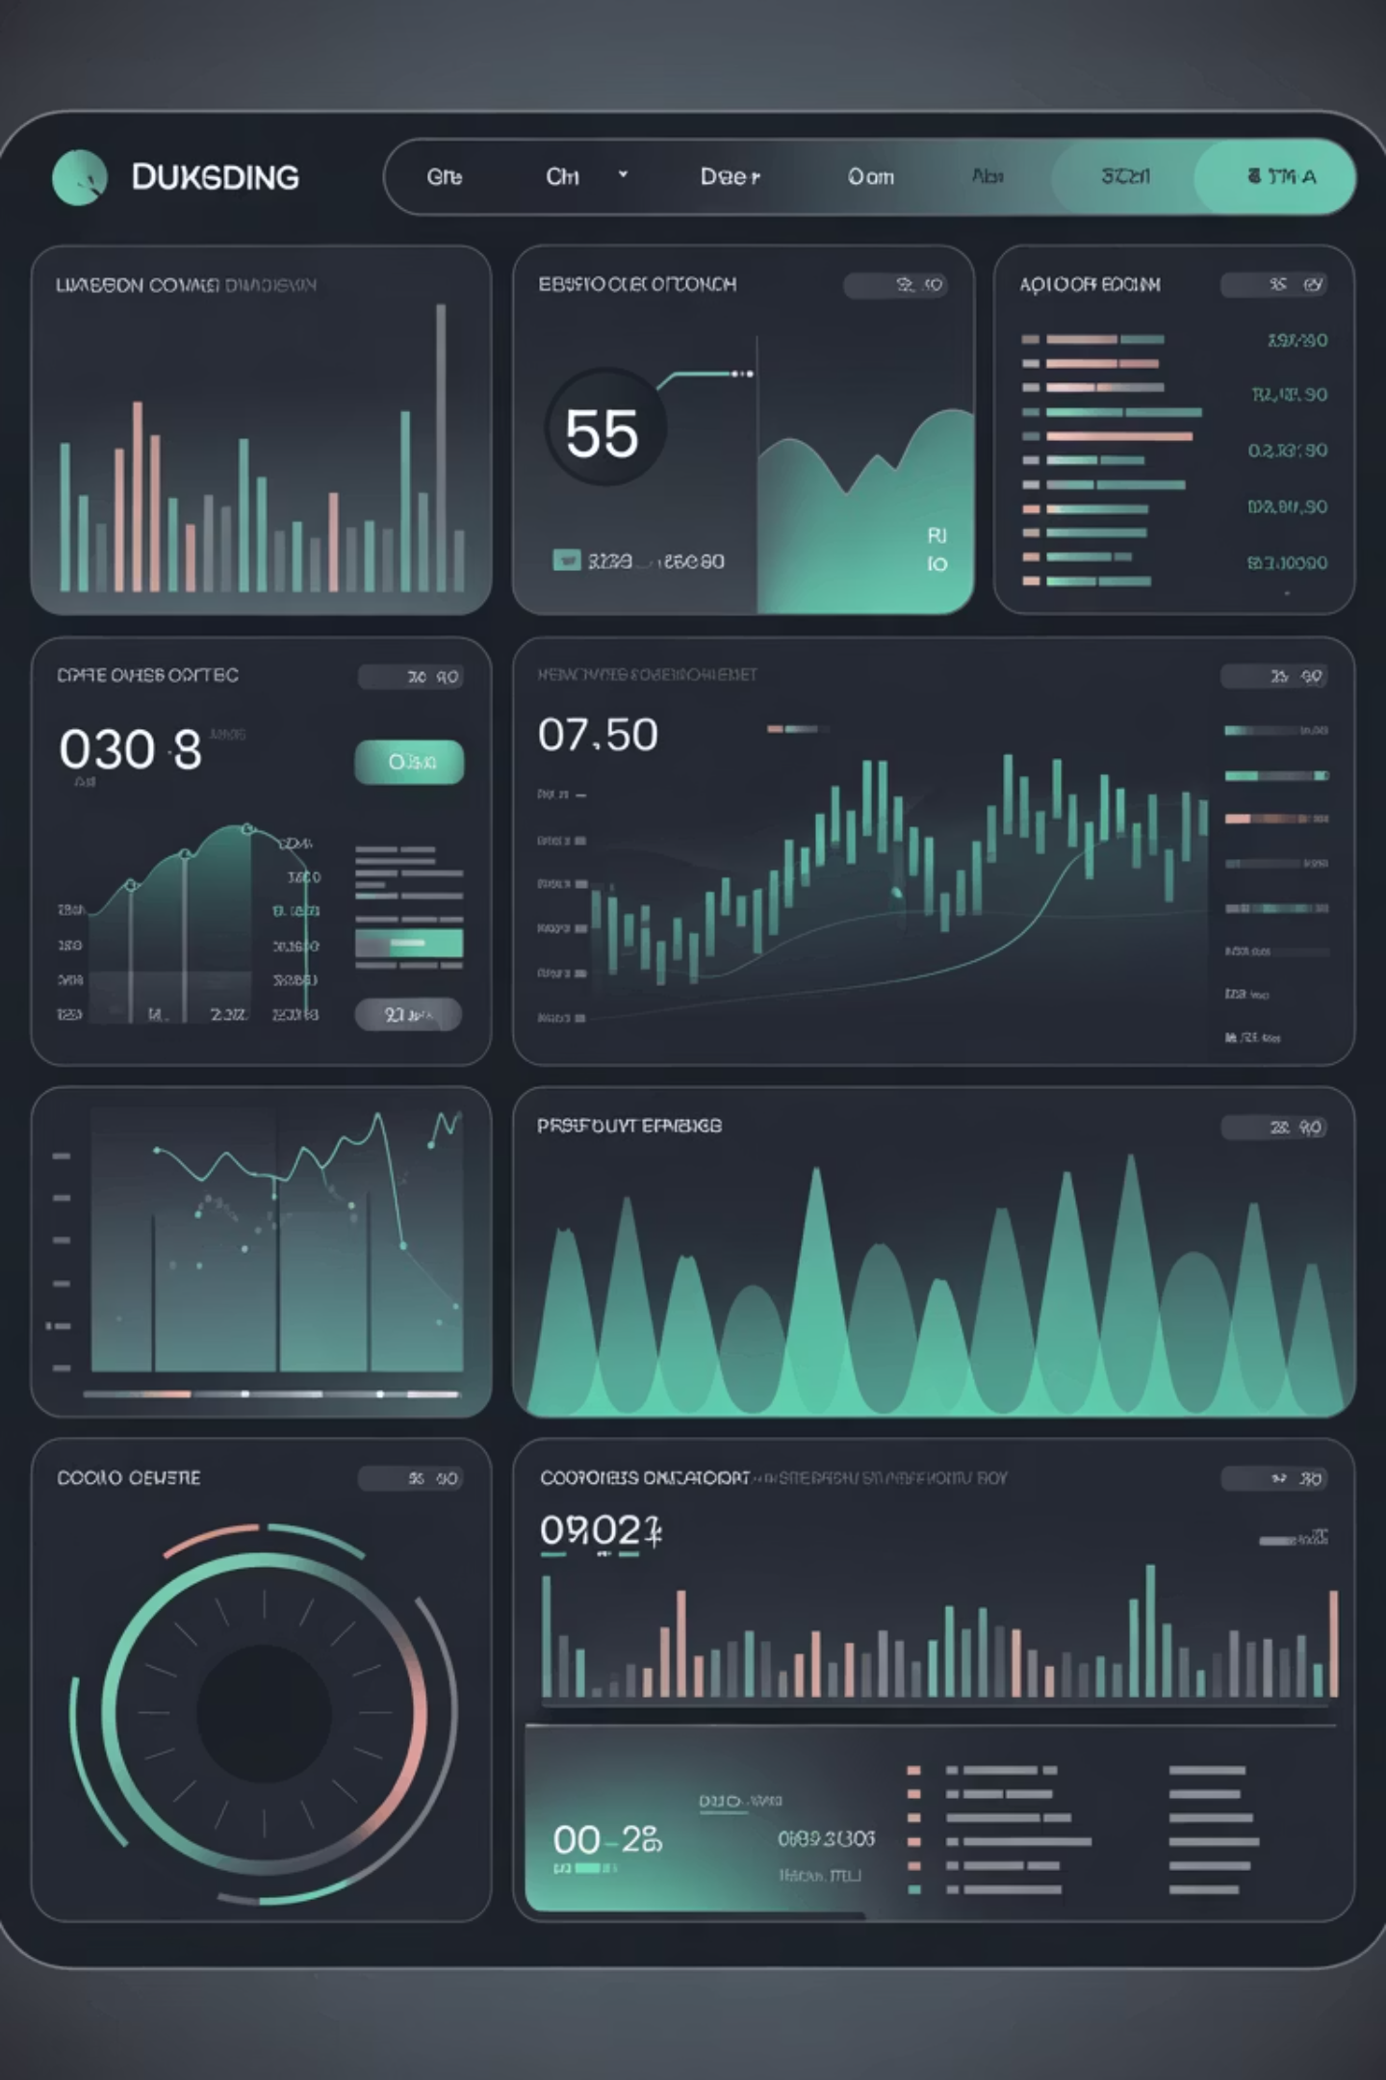
HorizonTrader
Technical Analysis Portfolio Management System
Team: Nithik Pandya, Ayush Dodia, Vraj Shah

Slide 2



System Overview
HorizonTrader empowers investors with technical analysis for diversified stock portfolios. It provides actionable recommendations and strategic guidance for 1, 2, or 5-year horizons, simplifying market data into interpretable Buy/Hold/Sell signals. Supports advanced, backtested strategies, including hedged multi-leg trades.
Empowering Every Investor
Smarter, Sustainable Growth
Built-in Risk Mitigation
Makes complex market analysis accessible to all, simplifying investment decisions with intuitive, rules-based insights.
Focuses on optimal, sustainable strategies. Reduces transaction costs and fosters consistent, long-term portfolio growth.
Offers advanced risk management, including hedged multi-leg trades, to moderate exposure and protect investments.

Slide 3



Core System Components
HorizonTrader's system processes raw data through analysis to inform strategic investment decisions.
Securities
Technical Indicators
Strategies
Real-time and historical stock data: the foundational layer.
Algorithms identify patterns, trends, and actionable signals from data.
Generate Buy/Hold/Sell signals for portfolio recommendations.
This seamless flow drives HorizonTrader's investment guidance.

Slide 4
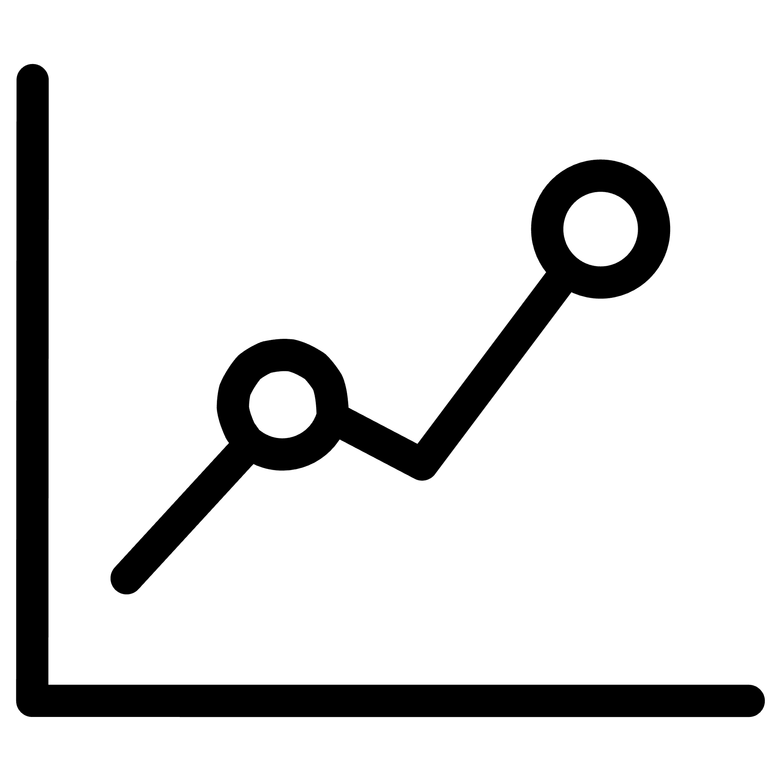




Technical Analysis Techniques
Simple Moving Average (SMA)
Exponential Moving Average (EMA)
Relative Strength Index (RSI)
Smooths price data to identify trend direction
Gives more weight to recent prices
Measures momentum and overbought/oversold conditions
More responsive to price changes than SMA
Calculates average price over specific time periods
Scale of 0-100: Above 70 = overbought, Below 30 = oversold
Better for short-term trend identification
Buy signals when price crosses above SMA
Helps identify potential reversal points
MACD (Moving Average Convergence Divergence)
Bollinger Bands
Shows relationship between two moving averages
Price channels based on standard deviation
Signal line crossovers indicate buy/sell opportunities
Upper/lower bands indicate volatility levels
Histogram shows momentum strength
Price touching bands suggests potential reversals

Slide 5
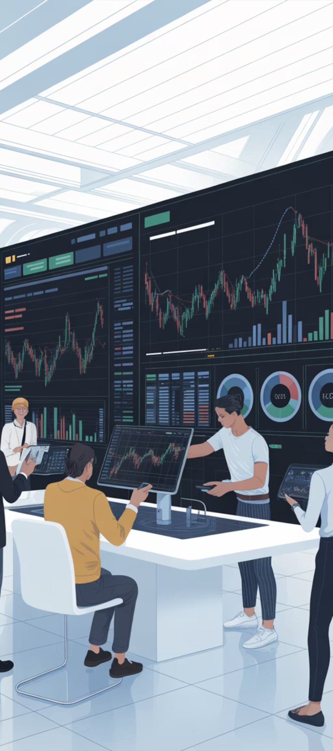
How We're Different: Serving Everyone
First-Time Investors
Seasoned Traders
Overall Benefits
Simplifies market analysis.
Actionable insights for diversified portfolios.
Consistent, long-term growth.
Indentify stocks to hold, buy or sell
Intuitive, rules-based decisions.
Optimal, sustainable strategies.
Clear market entry guidance.
Advanced risk management.
Navigate volatility confidently.

Slide 6
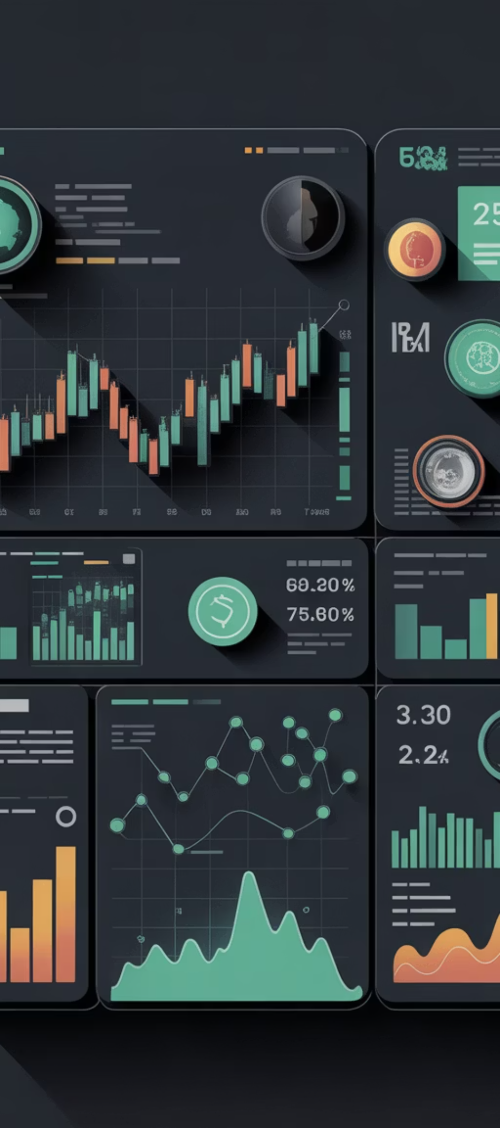
Smart Portfolio Management
Diversified Holdings
Manages a diverse portfolio (20 stocks + cash) for broad market exposure and stability.
Adaptive Strategy
Customizes management to your 1, 2, or 5-year investment horizon.
Controlled Risk
Enforces strict risk limits, keeping investments within your comfort zone.
Continuous Optimization
Real-time tracking and optimization to maximize growth and financial goals.

Slide 7

Advanced Risk Management
Our system uses strategic paired trades and hedging to reduce investment risk, protecting your portfolio from market fluctuations and ensuring stability.
Identify Paired Opportunities
Automated Hedging
Scans for correlated securities.
Balances positions to offset declines.
Dynamic Rebalancing
Enhanced Portfolio Stability
Adjusts hedging ratios dynamically.
Minimizes volatility, protects capital.

Slide 8
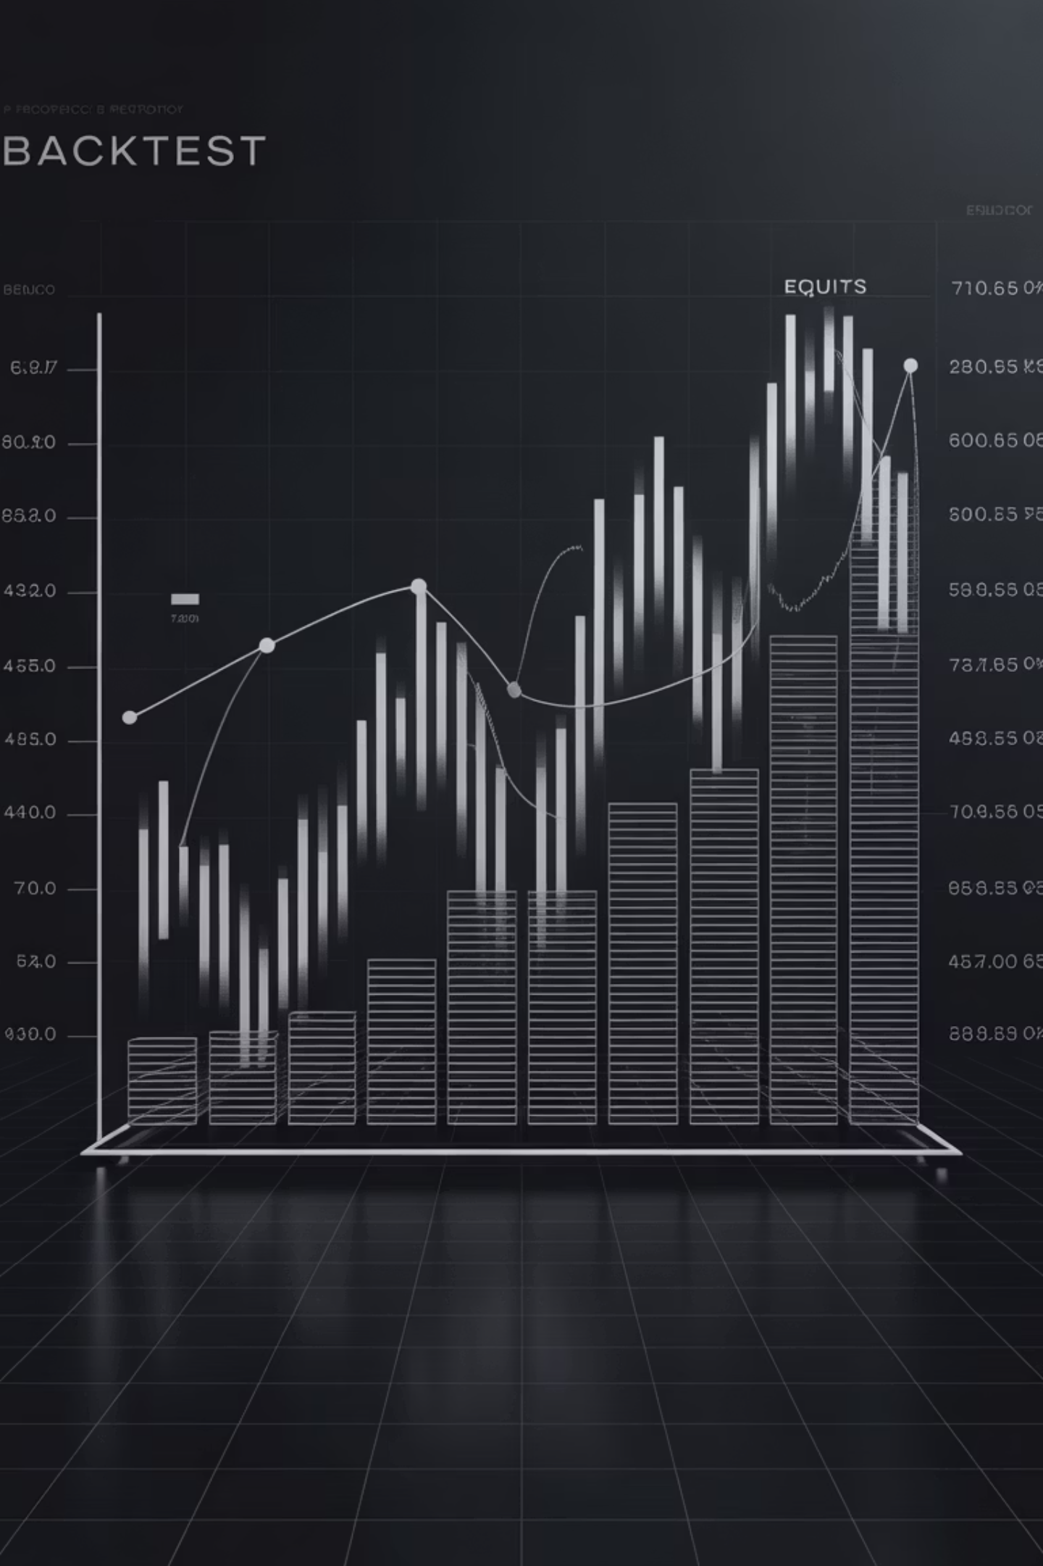
Proven Performance Validation
We will rigorously test and validate all investment strategies to ensure verifiable performance and peace of mind.
Historical Backtesting
Extensive simulation using decades of historical market data, demonstrating consistent effectiveness.
Real-Time Paper Trading
Continuously verified through live paper trading, confirming adaptability and reliability in current markets without risk.

Slide 9

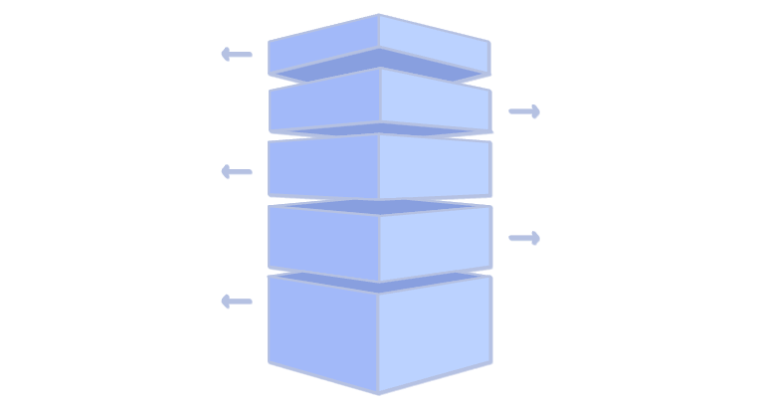
Comprehensive System Architecture
System Overview
Frontend Architecture
Three-tier architecture: Client, Application, Data, and External Services.
Next.js App Router structure for efficient navigation.
Modular component hierarchy.
Focus on scalability, security, and performance.
Zustand for optimized state management.
External Services
API client with Axios interceptors.
Effective data fetching patterns and file-based routing.
Alpha Vantage API for real-time market data.
TradingView widget for advanced charting and analysis.
Database Architecture
Security Architecture
Backend Architecture
MongoDB schema design (document structure)
Layered architecture (Route → Service → Domain → Data Access).
Indexing strategy for performance optimization
Robust authentication layers.
Express.js framework with a robust middleware stack.
Data relationships (embedding vs. referencing)
Comprehensive API security measures.
JWT-based authentication.
Streamlined trading system transaction flow.
Repository pattern for data access.
Multi-level caching strategy for performance.

Slide 10



Technology Stack
Backend
Frontend
AI & Development Tools:
Node.js + Express.js
Next.js 14 + React 19 + TypeScript
Claude 4.5 Sonnet
MongoDB + Mongoose
GPT-5
JWT + bcrypt for authentication
Tailwind CSS for styling
Cursor AI IDE
Security middleware (Helmet, CORS, Rate Limiting)
Zustand for state management
React Hook Form + Zod for forms
Recharts + TradingView for charts

Slide 11




Development Process, Prompts & AI-Assisted Engineering
Backend Development (Express.js)
Project Planning & Architecture
Implement modular Express.js backend with separate routers and secure authentication
Analyze current progress against implementation plan and identify remaining milestones
Design wallet system with $10,000 default balance and MongoDB transaction logging
Propose step-wise migration plan from existing setup to Express.js
Fetch current stock prices dynamically from Alpha Vantage API before trade execution
Outline detailed tech stack for migration, including API structure and middleware
Frontend Development (Next.js)
Database & Data Management
Create Next.js 14 frontend connecting seamlessly with Express.js backend
Integrate Alpha Vantage daily stock data API to update MongoDB automatically
Design modern, custom-themed UI using glassmorphism principles
Set up and schedule cron job to fetch and update daily stock prices
Develop dedicated 'Learn' page explaining technical indicators interactively
Verify cron job success with console logs and database inspection

Slide 12
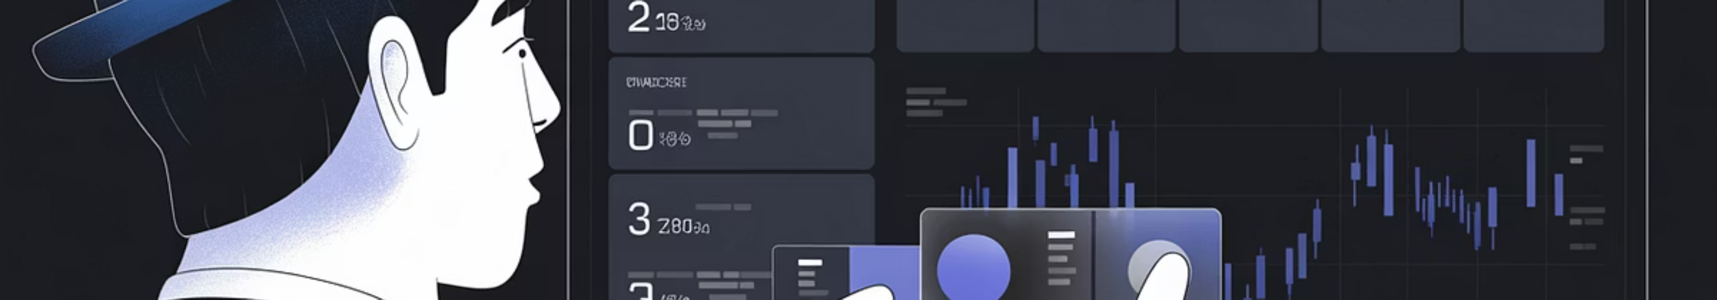
Live Demonstration Flow
HorizonTrader: Simplified investment journey.
01
02
03
Input & Horizon
Analysis
Recommendations
Enter stocks, set time horizon.
System validates and analyzes.
Buy/Hold/Sell signals.
04
05
Validation
Optimization
Backtesting & paper trading.
Monitor & rebalance.

Slide 13





Unlock Your Financial Potential
HorizonTrader empowers lasting wealth. Get institutional-grade analysis for clear, confident, and controlled investment decisions.
Effortless Clarity
Transform market data into clear buy/hold/sell decisions.
Sustainable Growth
Optimized strategies for long-term wealth building.
Secure Investments
Hedge risks with intelligently coupled trades.
Unwavering Confidence
Robust backtesting and paper trading validate strategies.
Shape a prosperous financial future. Intelligent, confident, sustainable investing starts now.

